Slide 1
Using Vespidae – Activity Log
Vinh Nguyen

Slide 2
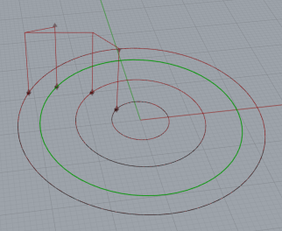
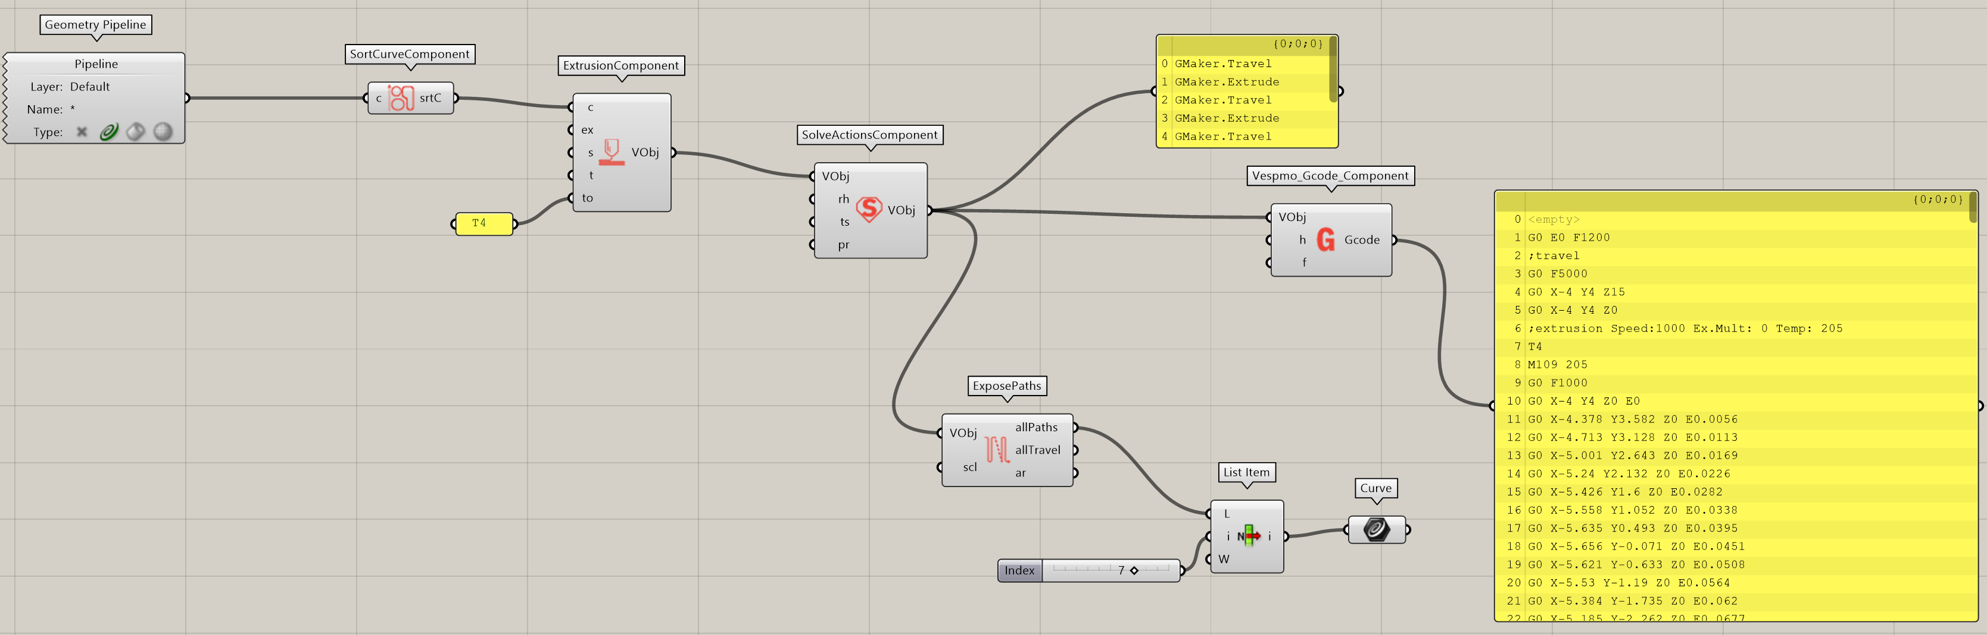
4/4/2022 Quick Tests
How does the sorting work again? Not sure why the highlighted circle ends up being the last circle that gets printed.
Wait just kidding that last one has a slightly higher Y coord because of where I clicked when I made the circle. This might be a mild annoyance/thing I need to remember if I’m building toolpaths in Rhino first instead of in Grasshopper
I realize I have to define my own brim so that my prints start off with filament. Makes sense to me, just hadn’t realized it at first

Slide 3
4/5/2022
Am currently trying to figure out how to connect my computer via ethernet to the Raspberry Pi. I want to make sure this setup isn’t going to wreck anything?
Actually, I can now open the DWC on my laptop, but the config with a Raspberry Pi does not allow network related commands (M552-554) that set an ethernet address. In that case, I’m not sure how the upload G-code process works??
Oh wait just kidding again. I’ve successfully uploaded that code!

Slide 4
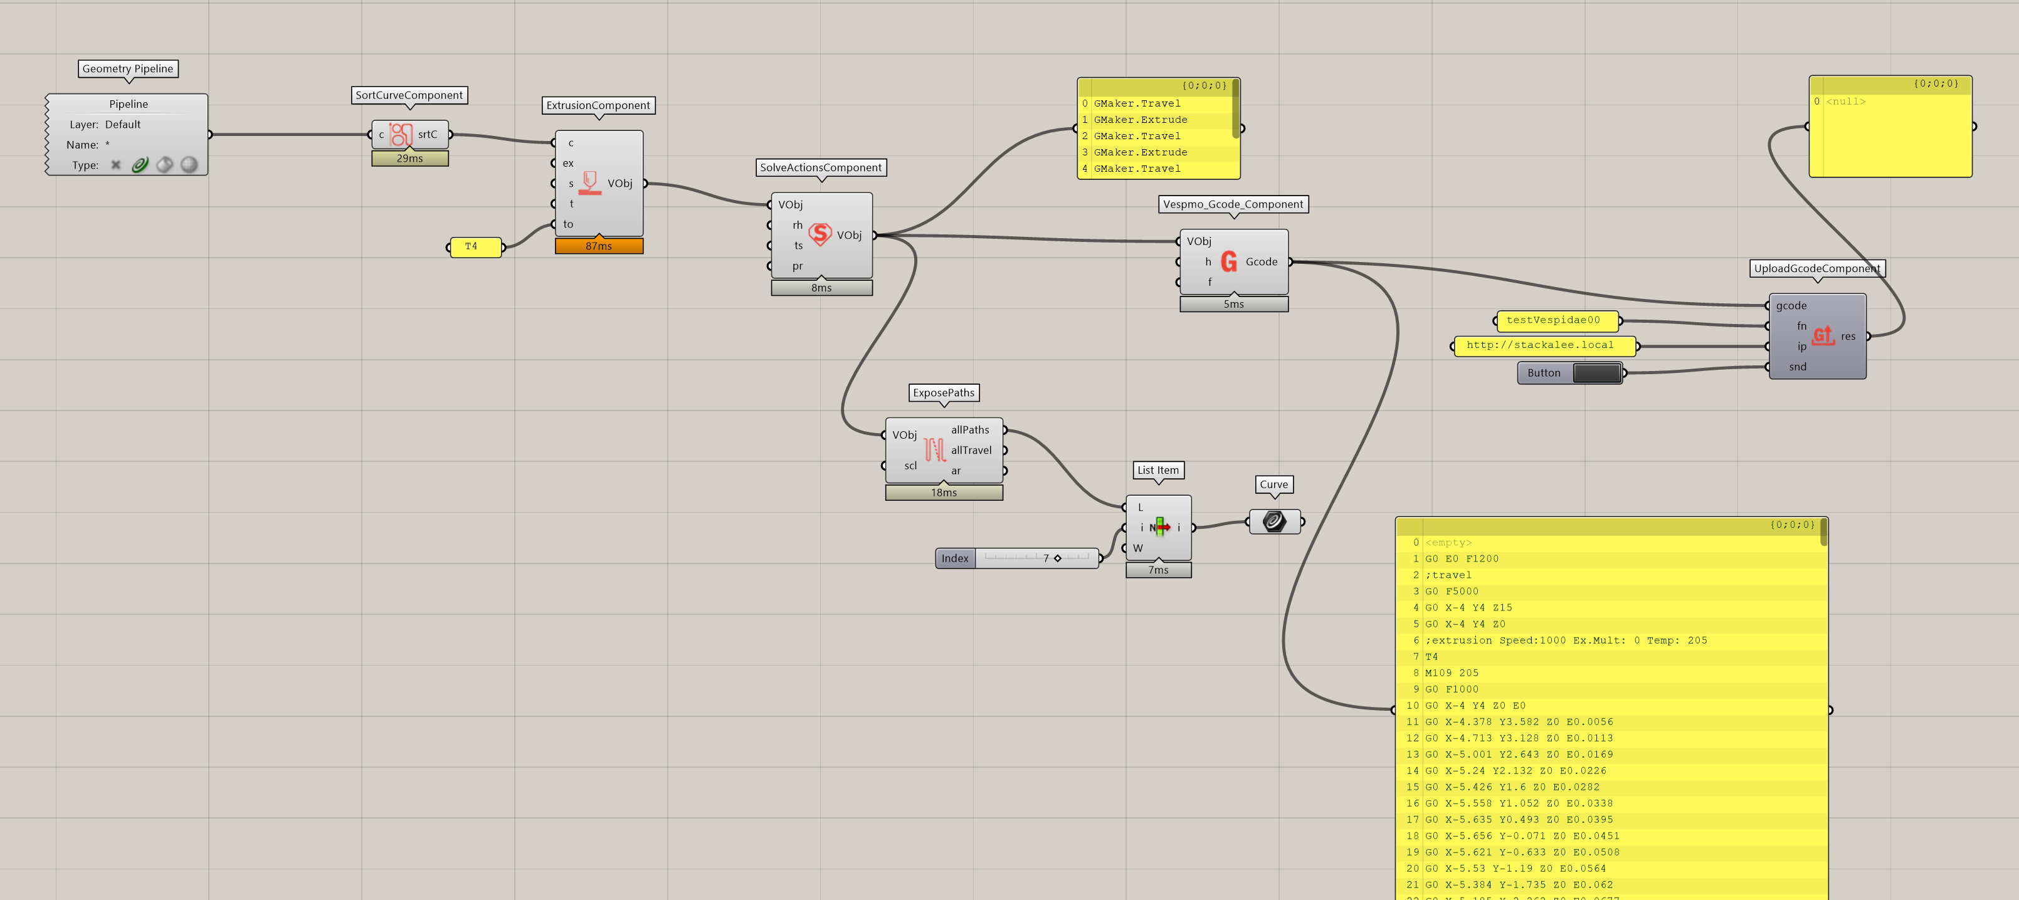
4/5/2022
This is the new grasshopper script. It uploads properly and the simulated movement succeeds. It didn’t like that first command, G0 E0 F1200, but after I commented that out, simulation was successful.

Slide 5
4/6/2022
Added the headers that I typically use for PrusaSlicer
Extrusion was way more than I expected. Realized that’s because slicers I use depend on relative extrusion values, while Vespidae uses absolute extrusion coordinates, which results in major overextrusion.
Changing the extrusion to absolute stopped the overextrusion, but the default multiplier is not enough, there’s almost no extrusion coming out in that case.
Extrusion multiplier 5 gets closest to an expected print, but ends of circles become little blobs

Slide 6
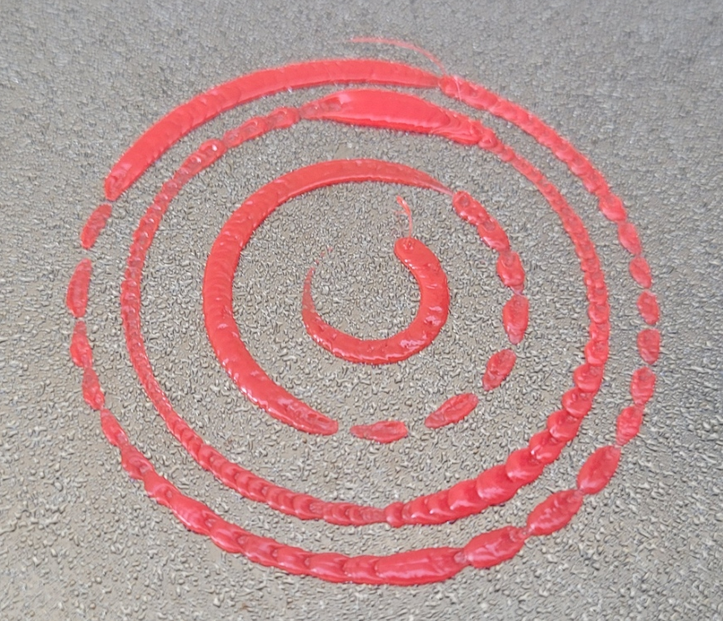
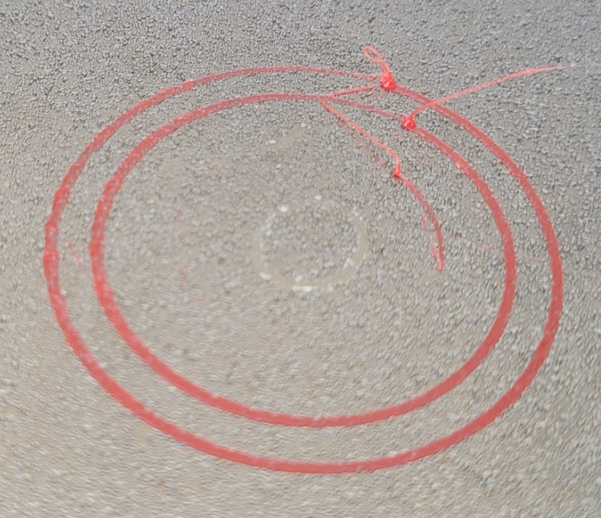
4/6/2022
When extrusion set to relative
Extrusion w/ 5x multiplier. Blobs at end of each curve

Slide 7
4/6/2022 Thoughts
The work and upload process is very convenient, feedback loop is much tighter from making small edits to printing
Extrusion multiplier/equation probably needs to be tweaked since a 5x multiplier gets me close to normal extrusion
First extrusion command before any tool selected will throw error. Possible to remove this?
Is it possible to do a relative extrusion to make it more consistent with other slicers? This is low priority though
Is there any option for extrusion retraction as well? To prevent blobs at end of each extrusion curve

Slide 8
Running To-Dos
Try one layer, tool switching
Workflow for that and seeing how I combine the gcode for each/how I’d like to do it
More consideration of my order of operations
Try a two or three layer thing
Try some interesting infills

